Slide 1
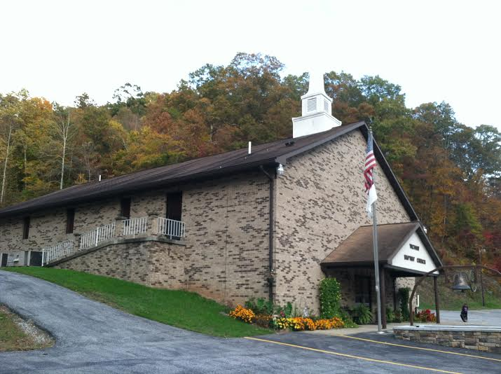
Celebrating
The Heroes of
Notes:
b

Slide 2
In modern popular fiction, a superhero (sometimes rendered super-hero or super hero) is a type of heroic character possessing extraordinary talents, supernatural phenomena, or superhuman powers and is dedicated to a moral goal of protecting the public.
Notes:
Google’s definition of a superhero

Slide 3
Min stry
WORKER
In reality, a Ministry Worker (sometimes rendered super-hero or super hero) is a type of heroic character possessing extraordinary talents, performing supernatural phenomena through Holy Spirit empowered abilities and is dedicated to a moral goal of protecting the public.
Notes:
Shari’s definition of a supergero

Slide 4
Superpowers
HEAR THE
CALL
Notes:
When someone called for Superman, he could hear them miles away, Your super hearing power is not quite that sensitive. But it is sensitive to role call. I’ve provided new Attendance charts for each of the youth classes. I think the kids will like seeing that we acknowledge their faithfulness. Kids are at mercy of parents usually, unless they’re bus kids so their absences can’t be viewed as a lack of commitment on their part. If their parents would bring them, they would come. As for the adults, they like acknowledgement too, but I also know that the adult classes have a lot more content and I don’t want to take away from your time, so two suggestions for Joe and Donnie is that you have a registry of your people, copy it each week and let them check their name off as they come in. This could be an And or an Or - - you could have table or row captains that will note who the regulars are on their row and if someone is missing. If we want the programs at Victory to grow we’ve all got to be more deliberate about some things.
We always say it’s not about the numbers. But the numbers are souls. So technically it is about the numbers.

Slide 5
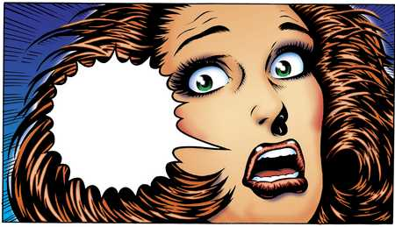
Superpowers
Spiritual Discernment
YIKES!
Notes:
Spiritual Discernment comes into play when we feel in our gut something is wrong, either with someone in our class, or with our class. Something’s not working. That could be any number of things.
Curriculum is not suited for the class
You’ve lost their attention… kids and adults are the same. You have to do something to keep their attention captivated. Small groups should feel comfortable asking questions, getting involved and being comfortable with their leader.
Class set up is wrong, it’s important with kids, but also adults. It’s hard to teach when everyone is scattered and it’s hard to teach when you’re on top of each other. Sometimes its just not an option so we have to work with what we’ve got, other times one small change can make the world of difference.
We always need prayer and we need warriors specifically on their knees for all of our programs.
Dr. Guiler taught me something about prayer - It works. They’ll rent a conference room at North Bend State Park and pray solid for 8 hours, and God is faithful.

Slide 6
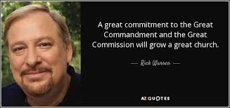
Superpowers
Commitment
Notes:
Superheroes are committed to the cause. I love the quote by Rick Warren who said that a great commitment to the great commandment and the great commission will grow a great church. We have wonderfully committed leaders… now we need wonderfully committed people.
One great statement from a website that I visited was- The members were allowed to join with no expectations placed on them. You get what you ask for! While becoming a Christian means to commit yourself to Christ, becoming a church member means to commit yourself to other Christians.
Apostle Paul mentions two different types of commitment in 2 Corinthians 8:5 -
⁵ And this they did, not as we hoped, but first gave their own selves to the Lord, and unto us by the will of God.
They gave their hearts to Christ… then to us. And Paul’s statement “not as we hoped for.” could either be construed as “even we didn’t expect they’d do it… or they did so much more than he had imagined… which is probably the correct way he meant it.
We have people who have given our hearts to the Lord… but not to us… meaning our church family.
I get tired of expecting the least. I went up stairs on Wednesday night a week ago and there was less than 50 people up stairs. I was frustrated for chief and God. But it’s what I expected.
So when I read that statement I wondered how many others expected it too, and why.
About a year ago there was a well explosion in Doddridge County. It was David’s well site and he was about two hours from being on location when it happened. He told me that evening that it was a good thing he wasn’t on the site when it happened because he would have ran into the fire where most people run away. Because that’s what firefighters do. He wasn’t kidding, that’s the commitment that David Johnson has to the profession.
That’s the commitment that I believe you guys have when it comes to fighting the fires of hell. I can call on anyone of you and you’re here. How do we instill that same passion in the rest of the congregation. Pastor Steven does a great job for morning worship, but I believe the foundation for church growth is going to be laid in the Sunday School hour because that is the a time of discipleship.

Slide 7
HORIZON
Tent Meeting
Promotion Sunday
Autumn Quarter
Notes:
I want today to be a bang kind of day to kick the Sunday School program back into gear and get us ready for the fall change of classes. This burden didn’t come upon me today, it’s been months in the making. I see us declining as a church and I think we’re resting on our laurels as they say. We were so proud that we stuck together as a group for over a year without a Pastor and then when we got a Pastor, it was like “whew!” glad that’s over, let’s rest.
No… let’s get busy!
I know it’s not you… you’re busy. But the many in the church are resting.
We have on the Horizon three things on the Sunday School Horizon.
Tent meeting where we can promote what’s happening
Promotion Sunday where we can excite the classes and students
The Autumn quarter to keep the momentum going into the winter quarter

Slide 8
Notes:
What we need to do:
Find someone to pray for our individual class and pray, pray, pray ourselves.
Find a curriculum that you’re happy with and suit it to your class
Let me know what you’re doing so I can promote it.

